Slide 1
MiWi Gateway with HMI Demo Setup Guidance
Aug,2021

Slide 2
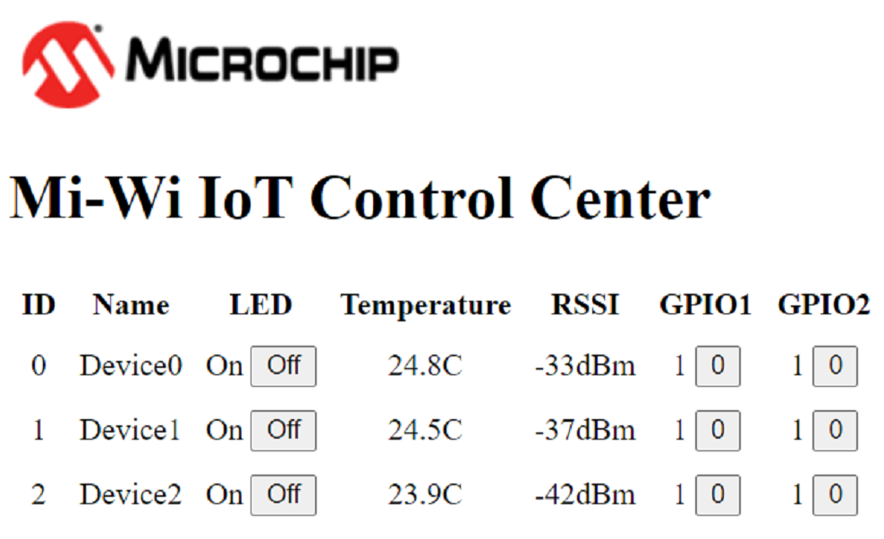
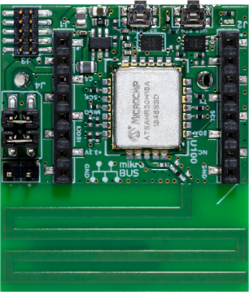

MiWi Gateway with HMI Solution
MPU HMI Solution
MiWi Wireless Solution
N
…
1
Light Control (LED)
Customized GPIOs
LCD
Gateway
SAMR30M Sensor Board
MPU
(ATSAMA5D27-WLSOM1)
MiWi wireless module
(SAMR30M)
UART
Current temperature
Current RSSI

Slide 3
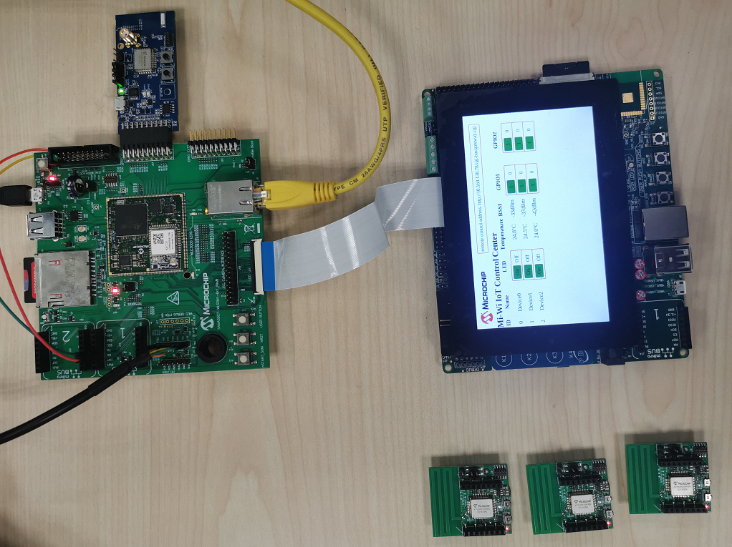
You can find each part through Microchip Website to build the demo.
PN: AC164159
ATSAMR30M Xplained Pro
PN: AC320005-5
LCD Display Module
https://www.microchip.com/en-us/development-tool/AC320005-5
https://www.microchip.com/en-us/development-tool/AC164159
PN: DM320117
ATSAMA5D27-WLSOM1-EK1
https://www.microchip.com/en-us/development-tool/DM320117
PN: DT100130
ATSAMR30M Sensor Board
https://www.microchip.com/en-us/development-tool/DT100130

Slide 4
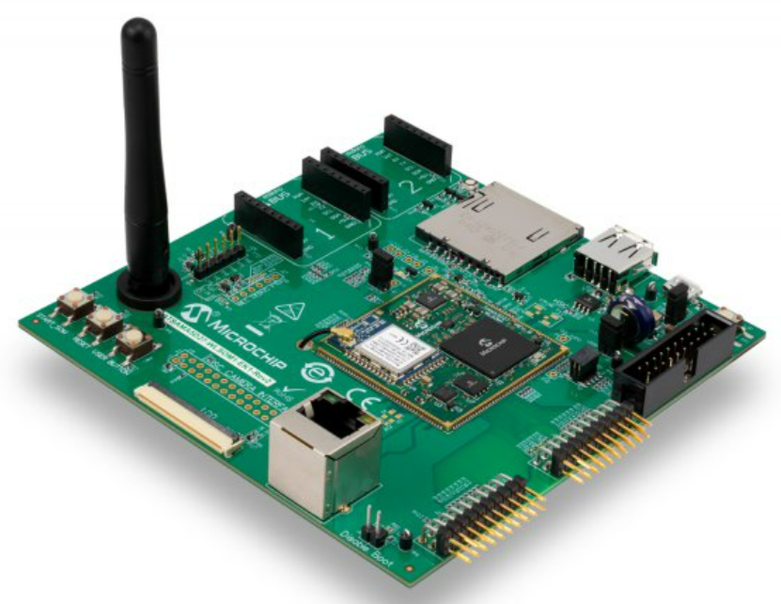
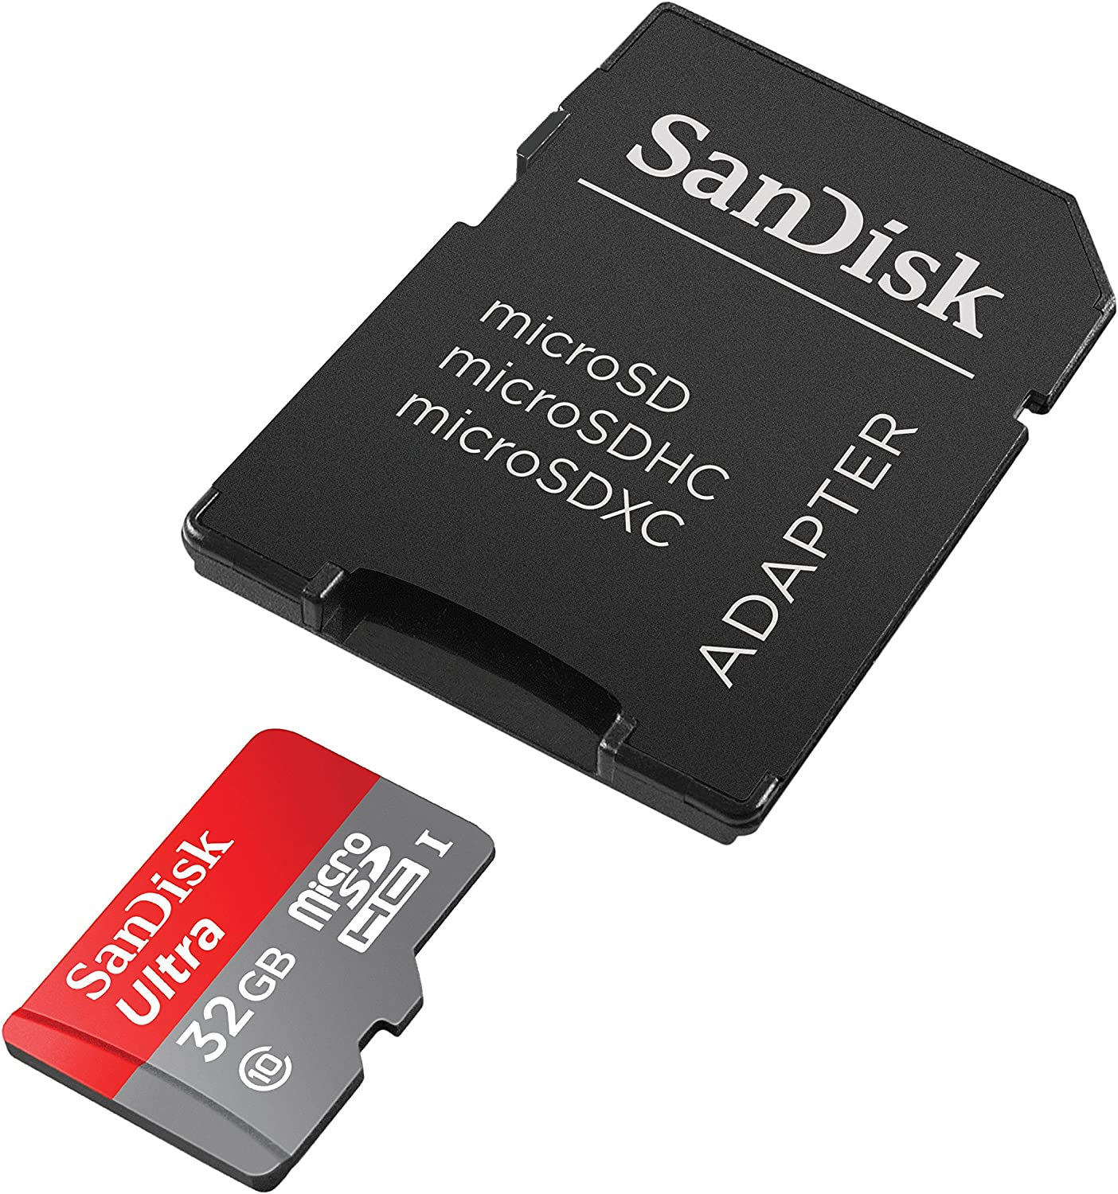
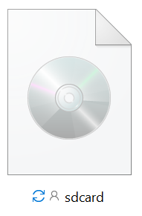


ATSAMA5D27-WLSOM1-EK1
-Prepare an SD card (size >= 8GB)
-Download the MPU ATSAMA5D27-WLSOM1 image from OneDrive:
-Flash the image to the SD card through balenaEtcher:

Slide 5
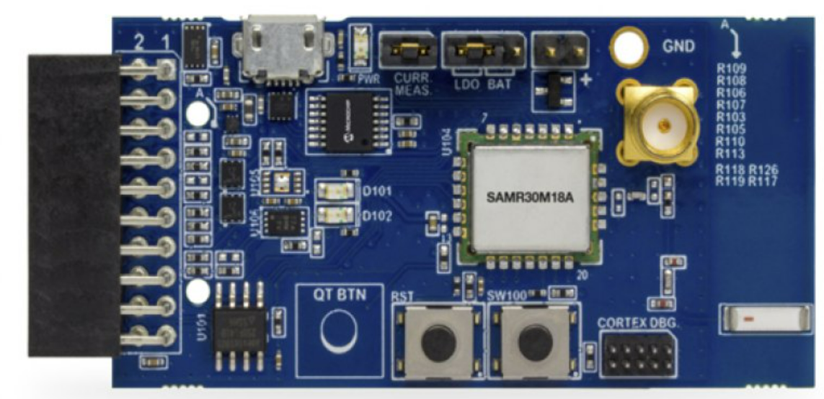
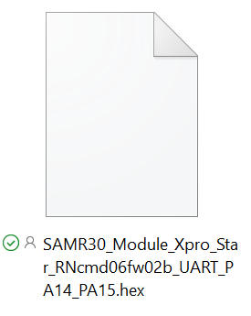
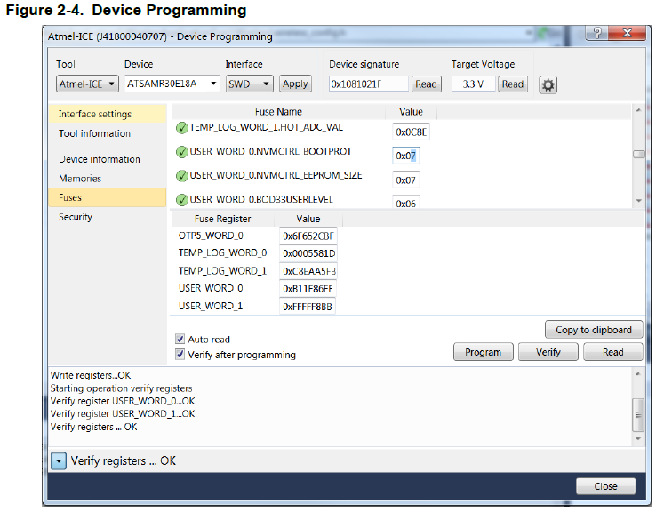
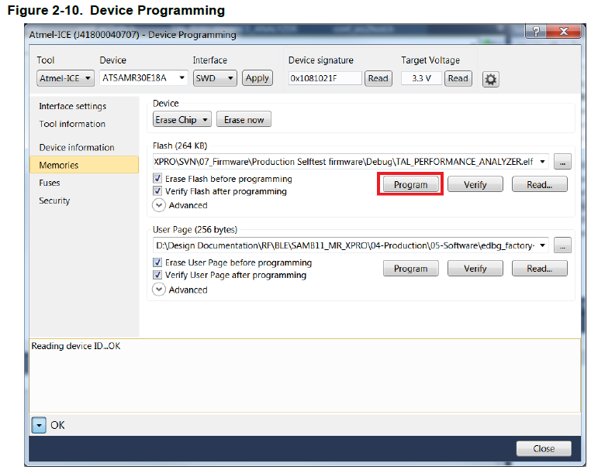
ATSAMR30M Xplained Pro
-Download the firmware for ATSAMR30M Xplained Pro from OneDrive.
-Device Programming, refer to SAMR30 module xpro user guide.
Choose “Tool”, “Device”, “Interface” like below, click “Apply”, then click the first “Read”
0x02
0x07
Choose path of firmware

Slide 6
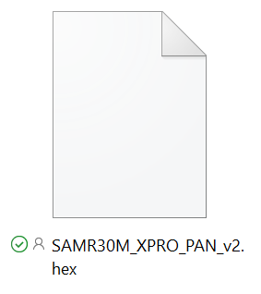

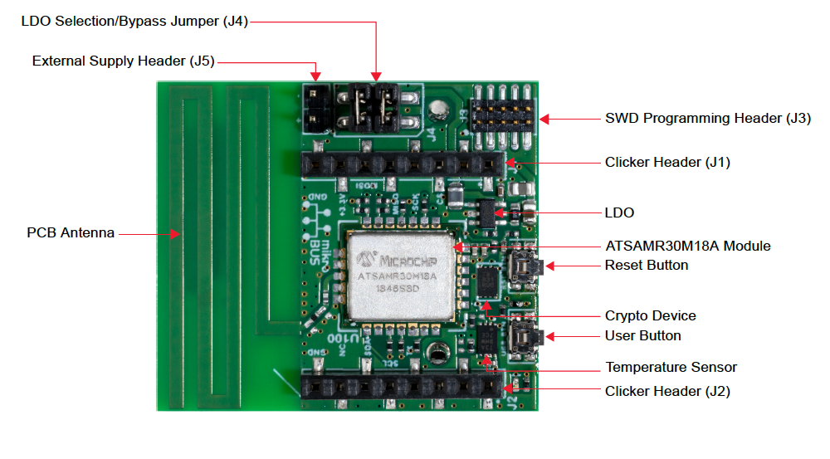
ATSAMR30M Sensor Board
-Download the firmware for ATSAMR30M sensor board from OneDrive.
-Device Programming, refer to ATSAMR30M-Sensor-Board-User-Guaid-DA50003015A.
Choose “Tool”, “Device”, “Interface” like below, click “Apply”, then click the first “Read”
Choose path of firmware
-Customized GPIOs of ATSAMR30M sensor board
PA06->GPIO1, PA07->GPIO2
PA06 is pin1 of J1 connector,
PA07 is pin2 of J2 connector.

Slide 7
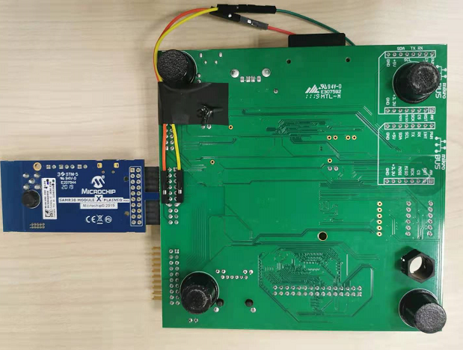
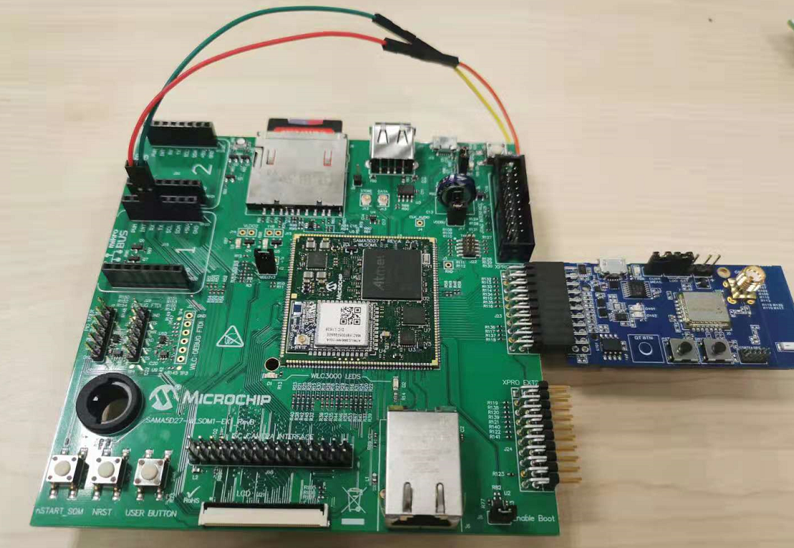
-Connect the ATSAMA5D27-WLSOM1-EK1 and ATSAMR30M Xplained Pro.
Cable 1->RX
Cable 2->TX
Cable 1
Cable 2
-Connect the ATSAMA5D27-WLSOM1-EK1 and LCD Display Module.
-Connect the SD card
-Connect Ethernet

Slide 8
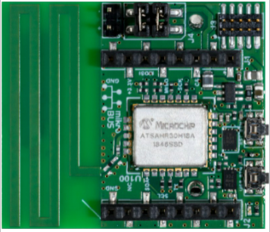

-ATSAMA5D27-WLSOM1-EK1 power-on
-Press nSTART_SOM on ATSAMA5D27-WLSOM1-EK1, wait about 25s until MPU starting up.
Press nSTART_SOM
-ATSAMR30M sensor board power-on.
Sensor board as end device need to be put into sleep mode after demonstration.
please refer to next page.
~Now you can start your demo~

Slide 9
Put MiWi Sensor Board Into Sleep Mode
Long press User Button on the board edge(press button over 2 Seconds), it will put SAMR30 Sensor board(End device) into backup sleep mode.
When the board(End device) entering sleep mode, LED will blink for 3 times to indicate this. After that, it will be in sleep mode.
After the board(End device enter sleep mode, only can use Reset button to restart the system.
About battery life
SAMR30 Sensor board uses CR2450 battery, when SAMR30 is running, the board consumes about 10~11mA current. When SAMR30 is in sleep mode, the board consumes about 110uA current.
One CR2450 battery(540mAh), it can support demo running about 50 hours in its full running mode, and support demo about 200days in sleep mode.

Slide 10
Thank you!

